Slide 1
Software Architecture & Construction
An introduction to Model Driven Architecture (MDA)

Slide 2
Basic UML Extension mechanism
Profiles
Stereotypes

Slide 3
Motivation
UML goal is to provide a standard modelling language
  Facilitate communication among developers, clients, tool developers, etc.
  But it is not a universal language …
Alternative
  Provide extension mechanisms to “customize” for different domains or applications

Slide 4
Profiles
Profiles are the most basic UML extension mechanism
A profile consists of three elements:
  Stereotypes
  Tagged-Values
  Constraints

Slide 5
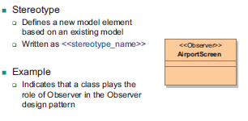
Stereotypes

Slide 6

Another example
Stereotypes can be applied to any UML element
  Classes, operations, fields, …
More than one stereotype could be applied to the same element
Example

Slide 7
So what?
What do we actually gain?
Advantages
  Visual annotation makes models easier to read
  Reuse of existing modeling language infrastructure
  Facilitate software automation
    Code generation
Disadvantages
  Overall tool support is inadequate

Slide 8

Tagged values
Tagged Values
  Name-value pairs that represent attributes of elements
Useful to
  Provide additional information

Slide 9
Constraints
Model elements usually have complex relations or properties
  Cannot be denoted only by graphical means
  Ex. A generalization always involves two classes
Object Constraint Language (OCL)
  UML’s standard language to specify constraints
  Describes more formally the conditions that the instances of a model should meet

Slide 10
OCL constraint types
Invariant
  State a condition that must always be met by all instances of an element
Precondition
  A restriction on an operation that must be true before it executes
Postcondition
  A restriction on an operation that must be true after it executes
Guard
  Constraint that must be true before a state transition fires

Slide 11
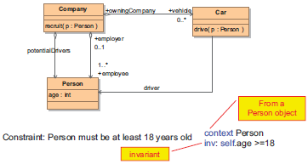
OCL example (Stahl et. al)

Slide 12
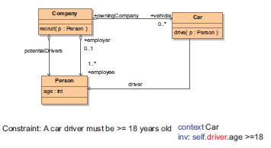
Another OCL example

Slide 13
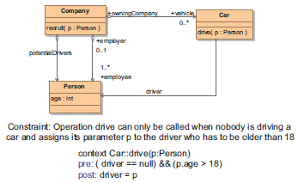
Last OCL example

Slide 14
Recap on Profiles
Profiles are the basic mechanism to extend UML
  Stereotypes
  Tagged Values
  Constraints
In practice
  Broadly used for all types of domains: components, testing, middleware, web services, etc.

Slide 15
interlude
Are profiles enough?
  Ans. No
  Why?
    We want to provide more extensible and flexible mechanisms to create customized types of models

Slide 16
Metamodelling

Slide 17
Perspective
A model is an abstraction of a system.
Some questions:
  How to define the syntax of a model?
  How to define the semantics (meaning) of a model?
  How can you tell when is a model well-defined?
  Meets the syntactic and semantic requirements

Slide 18

An example
We want to model a system of pets and owners with the following conditions:
  Dogs have exactly one owner and have a license number
  Citizens have name and can own at most 2 dogs

Slide 19

Metamodel
Metamodels describe what are the valid constructs of a model
For our example, its metamodel is:

Slide 20
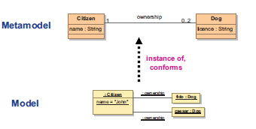
Pictorially

Slide 21
Languages and meta models
Models and Metamodels are written using a modeling language
  Ex. We used object diagrams and class diagrams of the Unified Modeling Language
Two dimensions for a language syntax:
  Abstract syntax: defines the structure of a language
  Concrete syntax: renders or realizes the abstract syntax

Slide 22
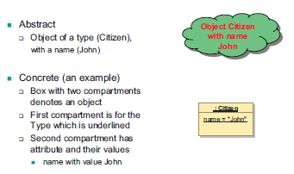
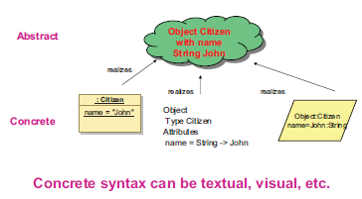
Abstract v. concrete syntax example
Example 1
Example 2

Slide 23
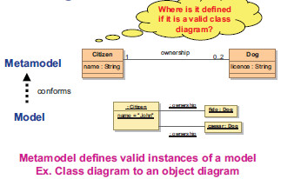
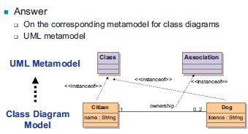
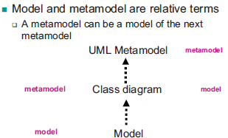
Revisiting…
Insight

Slide 24
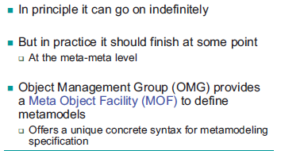
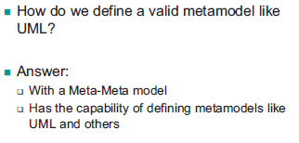
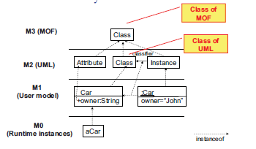
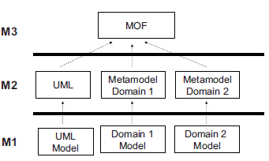
Now what?
Where does it stop?
Your own modelling language
OMG 4 layers
Other metamodels

Slide 25
Metamodelling in Eclipse
MDA
  The MDA process model
Metamodelling tools:
  Ecore
  EMF
  GMF
Example project demo

Slide 26
Your task
Design a metamodel for a simple library application.
  Main features
    Borrow Item
    Return Item
    Reserve Item
  An Item can be a book, a journal, magazine, etc
  Key stakeholders are Library user, Library staff, and University
Generate application code from your metamodel

Slide 27
Next time
Architecture styles
Architectural qualities

